Slide 1


Your Cover letter
Notes:
Welcome to the Career Center’s presentation on creating your cover letter! Today, we will discuss how you can write a tailored cover letter to support your resume. To get started let’s begin with a brief intro into what the Career Center is…

Slide 2
We educate and
empower students
and alumni in their development of lifelong career management skills.
Notes:
This is part of our Mission Statement. Our priority is educating and empowering students to design their own plan for their lives, and to make informed decisions about their major, experiences, and future. Notice the part that says, “LIFELONG career management skills…” The age most traditional college students expect to graduate with a bachelor's degree is around 21 or 22. According to research, the expected retirement age for this generation is 72. That’s a 50-year career lifespan! Therefore, it’s super important for you to be happy with your career choice!

Slide 3
Career Planning
Relationships
Experiences
Academic Subject Knowledge, Skill & Understanding
Transferable Skills
Emotional Intelligence
Notes:
The Career Center has an Employability Model and our acronym, CREATE, represents the skills, knowledge, understanding and personal attributes that make a person more likely to choose, secure and retain occupations that they can be successful and satisfied in.

Slide 4
What is a Cover letter?
1
Grab employer’s attention to your application
Research the
company
Connect your
experiences
& skills to their needs
2
Motivate them to extend an interview
Notes:
Employers tell us that they are looking for students that can articulate their skills and experiences through both verbal and written communication. A cover letter is a one-page letter of introduction where an individual explains their qualifications in a more detailed way than a resume. A cover letter accompanies a resume and is used to gain the employer’s attention to your application and motivate them to extend an interview to you. Even if a cover letter is not a required part of the job application, we strongly encourage you to include it, as cover letters are another way for you to explain your skills and qualifications. Submitting a cover letter when it is not required will not hurt your application, but not submitting one might make the difference in getting an interview.
CLICK
A cover letter is an opportunity for you to show that you’ve researched the company and can explain what you know about their products and/or services, as well as demonstrate to the company which relevant experiences and skills you have and how they will connect to their needs. With this in mind, each cover letter should be tailored to every position you apply to. It is important that you do not use the same generic cover letter for every job application.

Slide 5

Cover letter formatting
Cocky Gamecock
Columbia, SC | 803-777-1801
c.gamecock@sc.edu
Page length: 1 page
Margins: 0.5-1 inch
Font Style: Times New Roman, Arial, Calibri
Font Size: 10-12 pt.
Spacing: Single or 1.5 spacing
Emphasis: Bold, italics, UPPER CASE, underline
No colors
Format: Business letter with professional tone
May 1, 2020
Mr. Will Muschamp
Head Football Coach
University of South Carolina Athletics
1000 Gamecocks Way
Columbia, SC 29201
Dear Mr. Muschamp,
Body
Sincerely,
Cocky Gamecock
Cocky Gamecock
Notes:
In general, any cover letter you write should be no longer than one page and should include half inch to one inch margins. You should use single or 1.5 spacing throughout the document depending on how much you are filling one page. A good rule of thumb is to include more white space throughout the document between paragraphs rather than having a large white space at the end after your closing. We suggest that you use the same font style and font size that you use on your resume to keep the documents consistent. For example, if you are using Times New Roman in 12 point font, on your resume, you will also want to use Times New Roman in 12 point font on your cover letter. Every cover letter you submit to an employer should be the best representation of yourself and should be written using a business letter format and a professional tone.

Slide 6
BEFORE YOU BEGIN: DO RESEARCH
Mission
Vision
Values
Current News & Industry Trends
Resources:
O*Net
Occupational Outlook Handbook
Company’s Website
Handshake
Glass Door
Tip: Match your knowledge, skills, and abilities with the position, company, and industry
Notes:
Before you begin writing tailored cover letters, there are a few steps that you should complete. The first step is to do your research on the position, the company and the industry. Your research should focus on specifics that will be helpful to you as you are writing a cover letter and even later on in the hiring process when you may be interviewing. Focus on finding information about the company’s mission, their vision, their values and any current news or trends that might be applicable to the industry. When conducting research, utilize a variety of resources to get the best overall picture of the position, the company and the industry. To get an idea of what the ideal candidate would look like, consider checking out O*NET or the Occupational Outlook Handbook under the Bureau of Labor Statistics. With these two resources, you’ll be able to see the knowledge, skills and abilities required of that position, as well as the work activities and tasks one must face. To learn more about the company and the industry specifically, look at their website and social media accounts. From this research you’ll be able to express your interests and values and how closely they align to the company’s. To obtain more information on the work environment and how employers would describe the company, check out individual’s reviews on Handshake and on Glass Door. CLICK
When writing a tailored cover letter it is important to utilize this research to match your knowledge, skills, and abilities to those expectations of the position, company, and industry.

Slide 7
BEFORE YOU BEGIN: Understand the position
1
Read through the job description for general understanding
2
Read through the job description to identify variety of interests in position and company and underline them
3
Read through the job description to identify technical and softs skills necessary to complete job and highlight them
Notes:
You also need to make sure you understand the position and what the expectations are before writing a cover letter. Here we have laid out a sample Job Description Activity that you could do to make sure you fully understand it. It’s important to match the employer and position needs that are outlined in the job description. This activity will allow you to identify personal reasons you are interested in the position and company, and identify skills they are looking for in the ideal candidate.
To start, you will read through the job description for general understanding of the position and what they are looking for. You will then read it again specifically to identify interests in the position and company and underline them with pen as you go along. Lastly, you will read it a third time to identify technical and softs skills necessary to complete the job. As you search for these technical and soft skills, we encourage you to highlight them so you can later address them in your cover letter. In total, you should be reading the job description at least a few times to identify the reasons you are interested in the position and the knowledge, skills and abilities the company is looking for. It is not required that you complete this activity, but we do encourage you to do something similar to best aid you in writing a tailored cover letter.

Slide 8
Cocky Gamecock
ADDRESSING
Columbia, SC | 803-777-1801
c.gamecock@sc.edu
May 1, 2020
Mr. Will Muschamp
Head Football Coach
University of South Carolina Athletics
1000 Gamecocks Way
Columbia, SC 29201
Dear Mr. Muschamp,
ATTENTION & INTEREST
QUALIFICATIONS & FIT
Body
CLOSING & FOLLOW-UP
Sincerely,
Cocky Gamecock
SALUTATION
Cocky Gamecock
Notes:
Now that you’ve completed your research and fully understand the job description, you can begin writing your tailored cover letter. Next, we will go over how to address a cover letter, all that goes into the content of a cover letter, and the salutation. Note that for each job you apply to it is important to tailor the cover letter to the specific recipient and job description.

Slide 9
Addressing
Cocky Gamecock
Columbia, SC
803-777-1801
c.gamecock@sc.edu
Include your contact information
Utilize the same header on your resume if possible
Recipient's name and title
Include the employer’s contact information
Address the letter to appropriate individual by name
Ms. or Mr.
Dear Recruiting Manager or Dear Human Resources Director
Do not use “To Whom It May Concern”
May 1, 2020
Mr. Will Muschamp
Head Football Coach
University of South Carolina Athletics
1000 Gamecocks Way
Columbia, SC 29201
Dear Mr. Muschamp,
Notes:
Let’s begin with the header and who you address the cover letter to. Our first piece of advice is to include your contact information in the same format you did on your resume. By matching both headers, you keep things simple and consistent across all application documents you submit. You will also want to include an individual’s name and title, and the employer’s contact information. If a contact is not provided, you can address your cover letter by saying “Dear Recruiting Manager” or “Dear Human Resources Director”. If there is an individual's name listed in the job description for questions or application submission purposes, this is the individual that you will want to address your cover letter to. If their title is not included in the job description, you will want to research their title and include that in the header as well. The employer’s contact information should include the individual’s name, the company’s street address, city, state and zip code. After that, you will want to address the cover letter to the appropriate individual by name using a formal title such as Ms. or Mr.

Slide 10
First paragraph
ATTENTION & INTEREST
Body paragraphs
2-3 Qualifications & Fit
Final paragraph
Closing & Follow-up
= 3-5 Paragraphs
Notes:
The body of the cover letter is one of the most important parts of the document and will include all the details about your qualifications for the specific position you are applying to. A cover letter should generally include three to five paragraphs. Here, you’ll talk about your interest in the position or company and all the knowledge, skills and abilities you bring to the table that make you a qualified candidate for the position. Your cover letter should include three different sections and should normally be written in this order. The first paragraph will grab the attention of the employer and state your interest, your body paragraphs will display your qualifications and fit, and your final paragraph will include your closing and follow-up. Please note that your body paragraphs may be more than one paragraph depending on how you chose to format the experience you are highlighting in your cover letter.

Slide 11

Attention & Interest
Make it clear that you are interested in the position for more than just a J-O-B.
Start with a strong statement…capture their interest!
What position are you applying for?
How did you learn of the opening?
Include prior contact with the employer or employees in the organization you are applying to
Address a few interest areas about the position and the company that you underlined in the job description
Notes:
The first paragraph of a cover letter is meant to grab the attention of the employer and include specific reasons you are interested in their opportunity. You will want to be creative here and not just start your cover letter with something like “I and writing to express my interest in [blank position title]”. In your opening paragraph, you will also want to include the specific title of the position you are applying for and how you heard of the opening. If you have had prior contact with a human resources representative or an employee of the company, you can include their information and any conversation points. Most of this paragraph should focus around a few reasons why you are interested in this opportunity and should specifically use the ones you highlighted from the job description activity we completed. You may share specifics about the position, the company or both! This first paragraph is extremely important and will be a deciding factor in whether the individual continues to read on or not.

Slide 12
Qualifications & Fit
Answer the questions:
Why are you qualified?
What makes you stand out from other candidates?
Choose 1-3 experiences and highlight them as selling points
Incorporate the technical and soft skills you gained and what you learned
Provide examples of your accomplishments
Echo the language and terminology used in the PD
Do not repeat information word for word as it appears on your resume.
Notes:
The second paragraph is where you show the employer that you are qualified and fit the job description. In preparation for crafting this second paragraph, I encourage you to answer: why are you qualified for this position and what makes you stand out from other candidates? What knowledge, skills and abilities did you highlight in the job description that you can bring to the table?
After identifying those, choose 1-3 experiences and highlight them as selling points as to why you are the best candidate for the position. When mentioning these experiences, don’t just reiterate what is on your resume. Instead, incorporate the technical and soft skills you gained and include what you learned from these experiences and how that would impact your work with this specific company. With these examples, make sure to state your accomplishments and give an overview to why these are extremely important to the position and the daily tasks you would be completing. Your 2nd paragraph should be outlining why you are qualified while echoing the language and terminology they used in the position description. This is the main meat of your paragraph when you need to boast about yourself and sell all the wonderful experiences and accomplishments you may have had.

Slide 13
Closing & Follow-up
Restate your goal and why it is of interest to them
Tie your skills and experiences back to how you will contribute to their organization
Connect the dots for the employer!
Indicate your interest in the next step of the process
Thank the employer for his/her time and consideration.
Notes:
The third paragraph of your cover letter is a general closing and follow up paragraph. Here, you will want to restate your goal and why it is of interest to them as a company. In a quick sentence or two, you will want to tie your skills and experiences back to how you will contribute to their organization and connect the dots for the employer! Don’t leave anything for the employer to assume - make sure your cover letter states your interests specifically and highlights the experiences and skills you have that they are looking for. Before wrapping up, indicate your interest in the next step of the process and thank them for their time and consideration in reading your application documents.

Slide 14
salutation
Conclude with a formal business closing such as:
Sincerely
Regards
Yours Truly
Include your typed out name and your signature
Signature is only necessary when sending a paper copy
Stating “Enclosure: Resume“ is not necessary
Sincerely,
Cocky Gamecock
Cocky Gamecock
Notes:
In concluding your cover letter, choose a professional formal business closing such as: “sincerely”, “regards” or “yours truly” before including your typed name and your signature. The easiest way to include your signature, is to save your document as a PDF and then choose the “sign” option under “Fill and Sign”. Adobe will give you options to create your own signature or to use one of their pre-made signature templates. A professional closing and your name and signature are the only things you need to conclude a cover letter. Historically, individuals have included the phrase “Enclosure: Resume” on the bottom of their cover letter, but that is not 100% necessary anymore since most job applications are online.

Slide 15
Tips
1
Tailor each resume and cover letter to meet the needs outlined in the position description
2
Keep your audience in mind
3
Save application materials as a PDF and name file using your last name followed by what it is (ex. CockyCoverLetter)
4
Proofread and have your application materials reviewed
Notes:
We would like to leave you with some general cover letter tips to help you craft the best application document you can. As we have discussed many times today, it is extremely important for you to tailor each resume and cover letter to meet the needs outlined in the position description. Some companies will not look at applications that don’t include cover letters because they are not interested in individuals that chose not to go the extra mile. When writing your cover letter, keep your audience in mind and make sure to spell out any acronyms or technical jargon. Make sure to proofread both your resume and cover letter multiple times before submitting a job application. Finally, when submitting your resume and cover letters online, make sure to save both application materials as a PDF and name the files professionally using your last name. If you are interested in obtaining feedback on any of your application materials, please visit the career center.

Slide 16

Notes:
Need help selecting a major or determining how to get started on your career journey? We are here to help you Create Your Career from anywhere – In-person and virtually.

Slide 17
New CAREER STUDIO HOURS
IN-PERSON OR VIRTUAL
Monday – Friday
9am – 4:30pm
Thomas Cooper Library, Level 5
EXTENDED VIRTUAL
Sunday – Thursday
5pm – 7 pm
Schedule an appointment @ sc.joinhandshake.com
Notes:
We’ve got lots of available hours to meet with you whenever you need. Request to schedule a 20 minute in-person or virtual appointment at sc.joinhanshake.com.

Slide 18
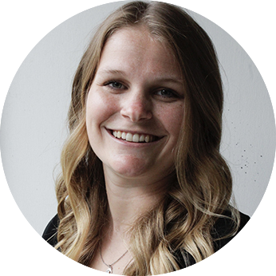
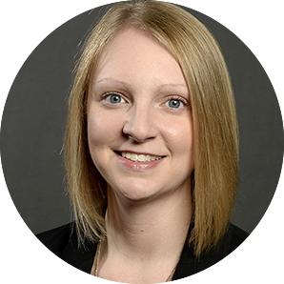
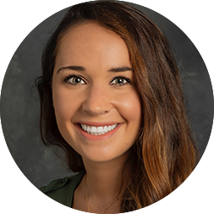

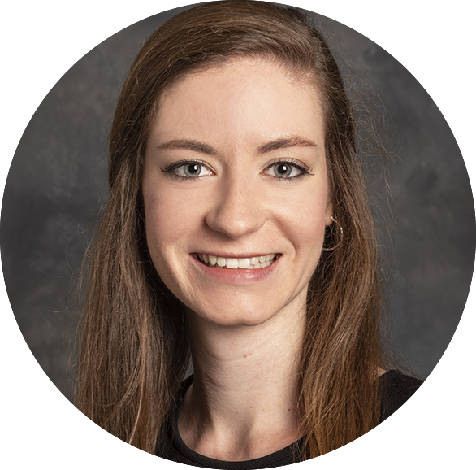
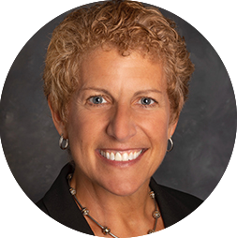

Ashley Chapman
Career Studio Coordinator
Jessica Gibson
Career Coach – CIC, HRSM,
1st Year Business
Rachael Silvey
Career Coach –
Health Professions
Holly Johnson
Career Coach –
Math, Sciences
Taryn Asbury
Career Coach –
Engineering & Computing
Jeanne Fitzgerald
Career Coach –
Arts, Education, Music,
Undeclared
Morgan Beatty
Career Coach –
Humanities, Social Sciences,
Psychology
CAREER COACHES
Notes:
Here are the full-time staff representatives that will be working with you to support your career journey! Career Development Coaches can help you learn more about yourself, the professional world, and how you fit into it. Throughout the process of deciding your major or career, you are encouraged to talk with a Career Center staff member who can guide you and answer your questions. Our staff members work directly with you to provide career advising, internship and job search guidance, and post graduation planning. In partnership with you, we can develop a career plan based on many factors, including your ambitions, values and interests.

Slide 19




Connect with us!
sc.edu/career
803-777-7280
@UofSCcareers
career@sc.edu
Notes:
Here is our contact information and social media accounts. We know that was a lot of information and planning a career can be stressful, so we are here to have fun and encouraging conversations to help you get to where you want to be!

